Slide 1
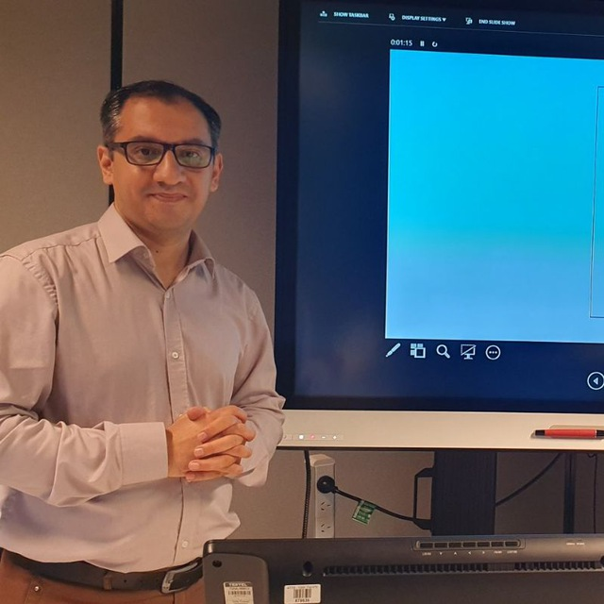
CEN207 – Creative Enterprise
Torrens University Australia
Lecturer/Learning Facilitator: Dr. Farshid Keivanian

Slide 2
Week 4 (Module 4): Entrepreneurial Project Management
1. Introduction to Entrepreneurial Project Management
2. Description
3. Creating and Utilizing Gantt Charts for Effective Project Scheduling
4. Implementing Risk Charts to Enhance Project Safety and Success
5. 12-step Project Management Process
6. Collaborative Strategies
7. Examples of Entrepreneurial Project Management
8. Case Studies Relating to AI, Software, and Game Development
9. Learning Activities
10. Attendance
11. Preparation for Assessment 2
** Integrating AI in Game Development: A Practical Approach

Slide 3
Open-Ended Question: Can anyone share what you think are the critical skills an entrepreneur should possess to effectively manage projects, especially in dynamic environments like tech startups?
Indeed, beyond just technical know-how, an entrepreneur needs a blend of leadership, risk management, and adaptive planning skills. These help navigate the complexities of projects that often have shifting scopes and evolving targets. For instance, in Sydney's fast-paced startup scene, entrepreneurs frequently adjust their project trajectories to align with real-time market feedback and emerging tech trends.

Slide 4
Follow-Up Question: How do you think these skills influence the success of a project in sectors like technology or e-commerce?
Flexibility and quick decision-making are key to success in technology and e-commerce because these sectors are highly dynamic and competitive. Flexibility allows organizations to adapt to rapid market changes, such as shifts in consumer preferences or technological advancements. Quick decision-making enables businesses to capitalize on emerging opportunities, respond to threats more effectively, and innovate continuously, keeping them ahead in the market.

Slide 5
Follow-Up Question: Can anyone give an example of a project where flexibility and quick decision-making led to its success or failure?
Example of Success:
Amazon's launch of AWS is a testament to the power of flexibility and rapid decision-making. By quickly capitalizing on the emerging cloud computing technology and adapting their infrastructure, Amazon not only created a new revenue stream but also established a dominant position in the cloud services market.

Slide 6
Example of Failure:
BlackBerry's decline illustrates the consequences of poor flexibility and slow decision-making. As the smartphone market evolved towards touchscreens and app-centric models, BlackBerry's delayed response and commitment to traditional designs caused them to lose market share and relevance, demonstrating how crucial these skills are in technology and e-commerce sectors.

Slide 7
1. Introduction to Entrepreneurial Project Management
Welcome to Module 4: Entrepreneurial Project Management. This module explores the synergy between project management and entrepreneurship. It emphasizes the need for entrepreneurs to master project management skills to drive innovation and achieve business success effectively. You will delve into essential techniques such as Gantt charts and risk management, tools that are pivotal in planning and executing projects in a dynamic business environment.

Slide 8
2. Description
Entrepreneurial Project Management combines traditional project management principles with an entrepreneurial mindset. This approach focuses on flexibility, rapid decision-making, and a proactive stance in project execution, making it ideal for startup environments and innovative projects. This module will cover the basics of setting up and using Gantt charts for project scheduling, risk charts for anticipating potential challenges, and developing comprehensive marketing and financial plans.

Slide 9
Open-Ended Question
What are some of the challenges you might foresee in scheduling complex projects, and how do you think a tool like a Gantt chart could address these challenges?
Scheduling can indeed get quite tangled with projects that have multiple overlapping activities. A Gantt chart offers a visual timeline for each task and shows dependencies between activities, which is crucial for understanding the flow of a project. For example, when a tech company in Melbourne launches a new app, using a Gantt chart can help them clearly mark out phases from development to testing, and adjust schedules in real-time as tasks shift.

Slide 10
3. Creating and Utilizing Gantt Charts for Effective Project Scheduling
Creating a Gantt chart in Excel involves a series of steps that help us visualize project schedules, assign responsibilities, and set deadlines effectively. Here’s a guide on how to create a Gantt chart:

Slide 11
3. Creating and Utilizing Gantt Charts for Effective Project Scheduling
1. Set Up Your Data
Start by setting up a table in Excel with the necessary columns:
Task Name: List all tasks involved in the project.
Start Date: Date when each task begins.
Duration: Length of time (in days) each task will take.
End Date: This can be calculated using the formula =Start Date + Duration.

Slide 12
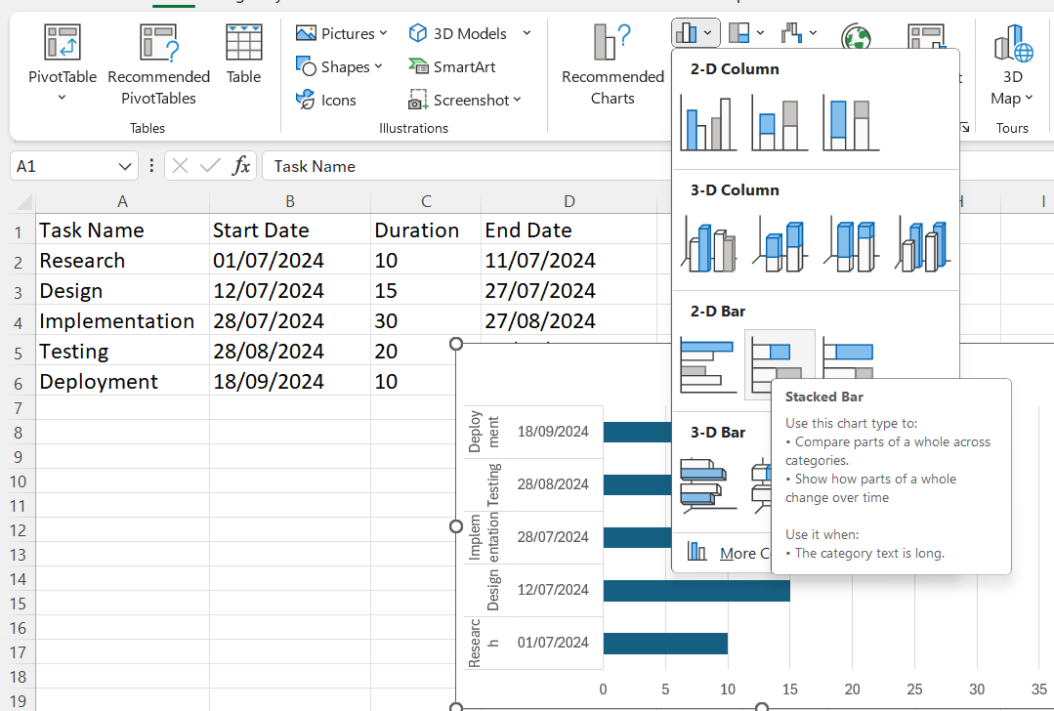
3. Creating and Utilizing Gantt Charts for Effective Project Scheduling
2. Insert a Stacked Bar Chart
Select the data for your chart:
Highlight the cells containing the Task Name, Start Date, and Duration.
Go to the Insert tab, click on Bar Chart, and choose Stacked Bar.

Slide 13
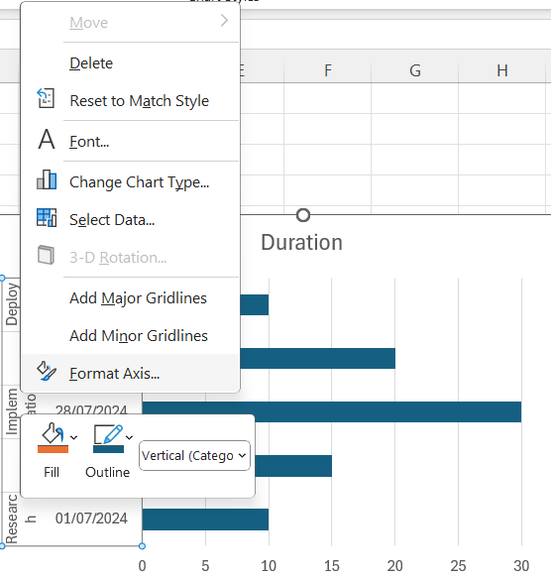
3. Creating and Utilizing Gantt Charts for Effective Project Scheduling
2. Format the Chart for Gantt Usage
Reverse Task Order: Right-click on the task names on the y-axis, select Format Axis, and check Categories in reverse order to display the tasks in the correct order from top to bottom.

Slide 14
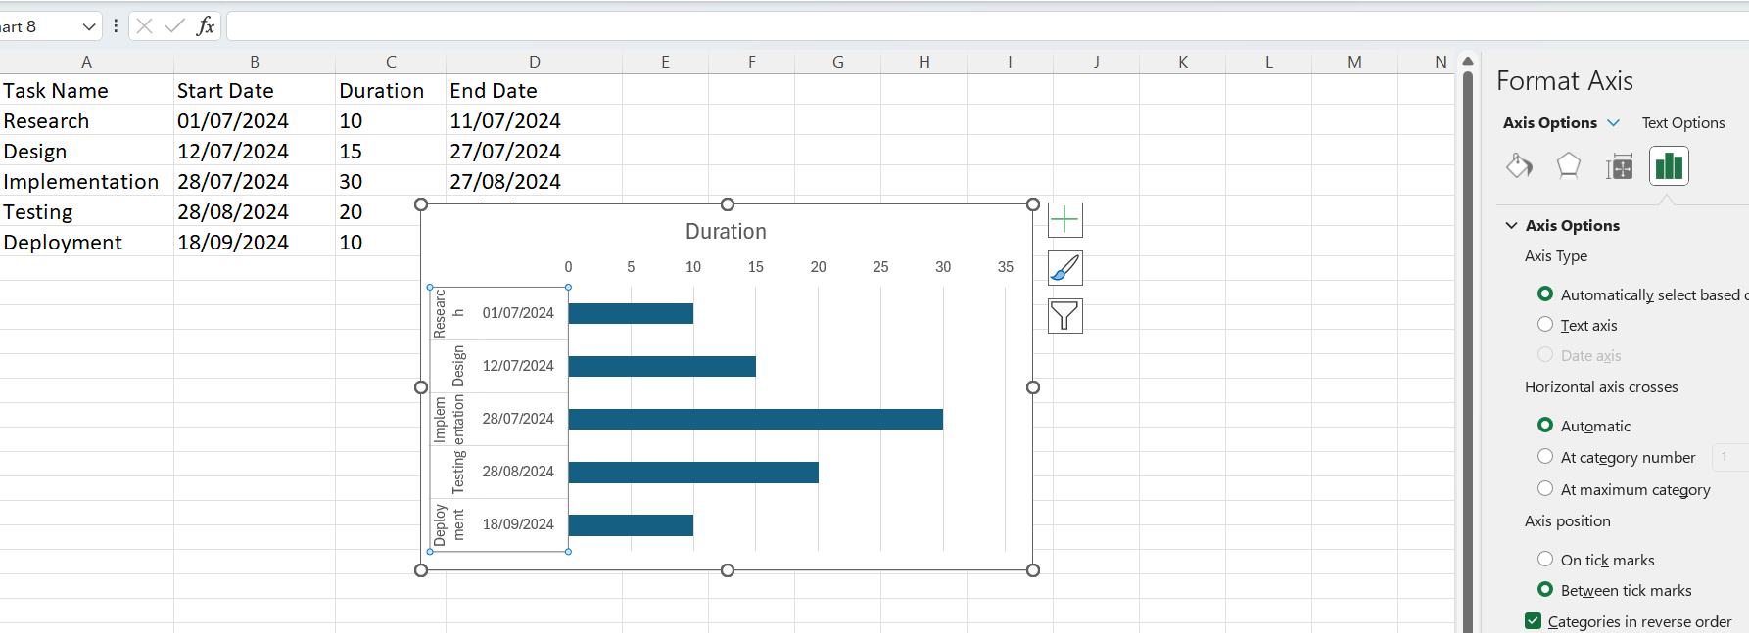
3. Creating and Utilizing Gantt Charts for Effective Project Scheduling
2. Format the Chart for Gantt Usage
Reverse Task Order: Right-click on the task names on the y-axis, select Format Axis, and check Categories in reverse order to display the tasks in the correct order from top to bottom.

Slide 15
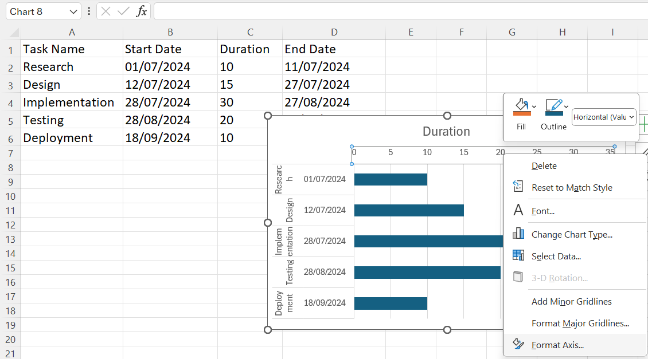
3. Creating and Utilizing Gantt Charts for Effective Project Scheduling
3. Format the Chart for Gantt Usage
Adjust Date Axis: Click on the date axis, right-click, and select Format Axis. Set the bounds and units according to your project timeline, typically with days as the unit.

Slide 16
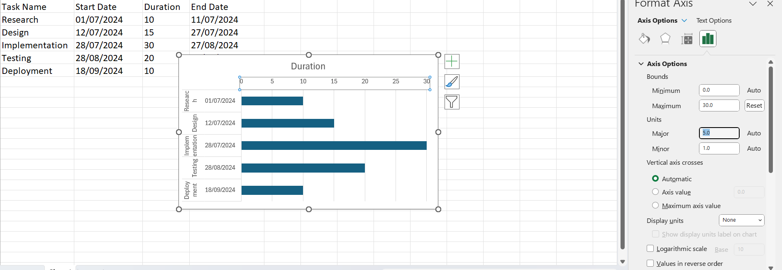
3. Creating and Utilizing Gantt Charts for Effective Project Scheduling
3. Format the Chart for Gantt Usage
Adjust Date Axis: Click on the date axis, right-click, and select Format Axis. Set the bounds and units according to your project timeline, typically with days as the unit.

Slide 17
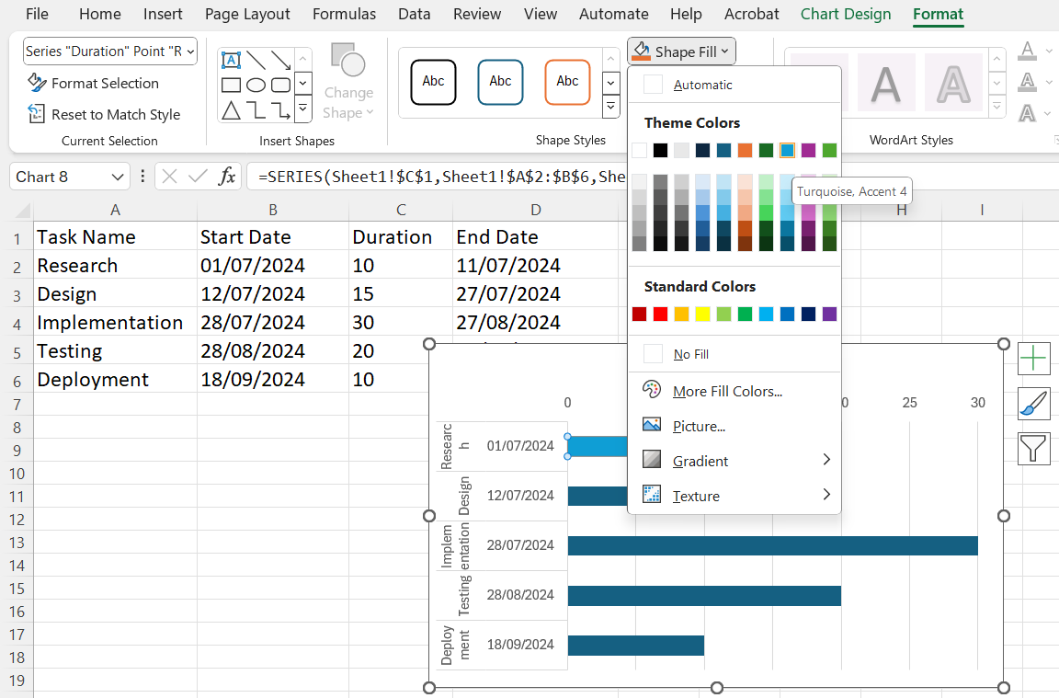
3. Creating and Utilizing Gantt Charts for Effective Project Scheduling
4. Add Durations and Milestones
To color code different phases or important milestones, we can manually change the color of specific bars by clicking on them and selecting a new fill color under the Format tab.

Slide 18
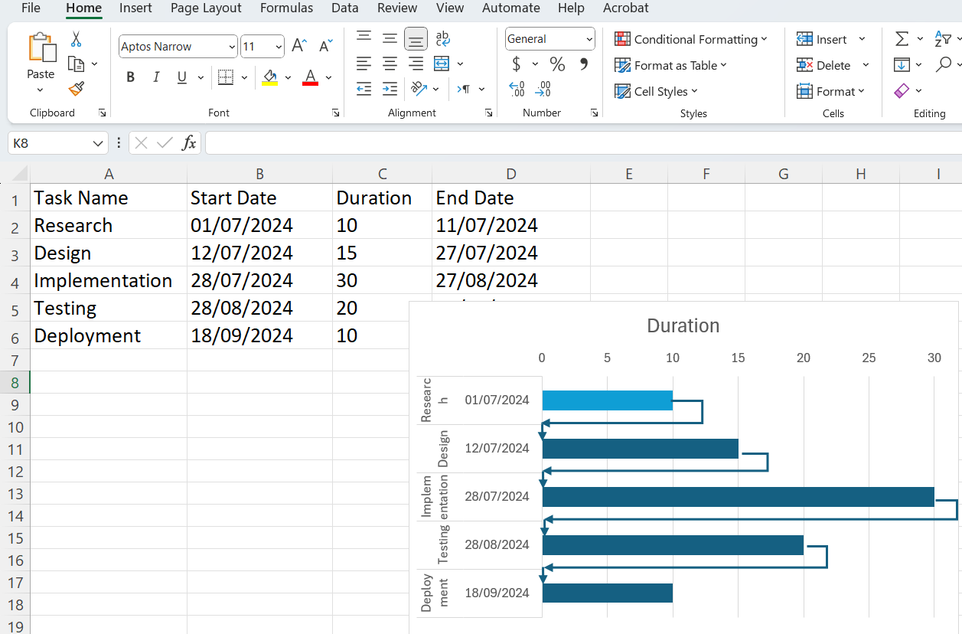
3. Creating and Utilizing Gantt Charts for Effective Project Scheduling
5. Add Dependencies (Optional)
If tasks are dependent on each other, you can add arrows manually or use shapes to indicate dependencies, making it clear which tasks cannot start until others are completed.

Slide 19
3. Creating and Utilizing Gantt Charts for Effective Project Scheduling
What is a Gantt Chart used for in project management?
A) Risk assessment
B) Scheduling tasks
C) Financial planning
D) Performance reviews

Slide 20
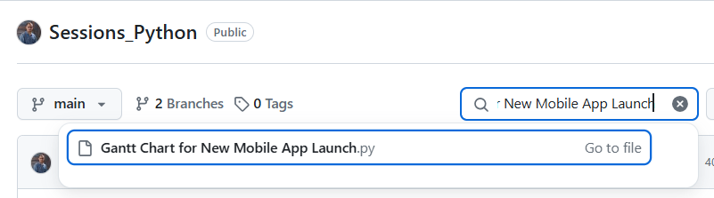
3. Creating and Utilizing Gantt Charts for Effective Project Scheduling
Exercise:
Create a Gantt chart for launching a new mobile app. Include at least 5 key activities.

Slide 21
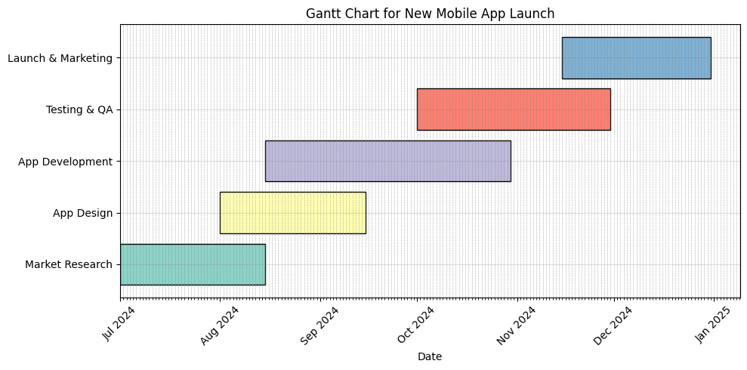
3. Creating and Utilizing Gantt Charts for Effective Project Scheduling
Exercise:
Create a Gantt chart for launching a new mobile app. Include at least 5 key activities.
The code generates a Gantt chart detailing the timeline of various activities related to the launch of a new mobile application.

Slide 22
3. Creating and Utilizing Gantt Charts for Effective Project Scheduling
The Gantt chart visualizes the timeline for launching a new mobile app. It includes key activities such as Market Research, App Design, App Development, Testing & QA, and Launch & Marketing, plotted across a timeline starting from July 2024. Each activity has a specific start date and duration, represented in different colors for clear distinction.

Slide 23
4. Implementing Risk Charts to Enhance Project Safety and Success
Risk charts, often known as risk matrices, are a valuable tool for identifying, categorizing, and managing potential risks in a project. They help visualize the probability and impact of each risk, aiding in the development of effective risk mitigation strategies.
1. Identify Risks
Begin by listing all potential risks that could affect your project. Engage your team, stakeholders, and use historical data to ensure comprehensive risk identification.
2. Categorize Risks
For each identified risk, assign:
Probability: The likelihood of the risk occurring (e.g., Low, Medium, High).
Impact: The potential effect on the project if the risk occurs (e.g., Low, Medium, High).

Slide 24
4. Implementing Risk Charts to Enhance Project Safety and Success
3. Create the Risk Matrix
Use Excel or any spreadsheet tool to create a grid:
The vertical axis (Y-axis) represents the impact, usually with higher impacts towards the top.
The horizontal axis (X-axis) represents the probability, with higher probabilities towards the right.

Slide 25
4. Implementing Risk Charts to Enhance Project Safety and Success
4. Plot the Risks
Place each identified risk in the appropriate cell based on its assigned probability and impact. You can use different shapes or colors to represent different types of risks or their priority level.

Slide 26
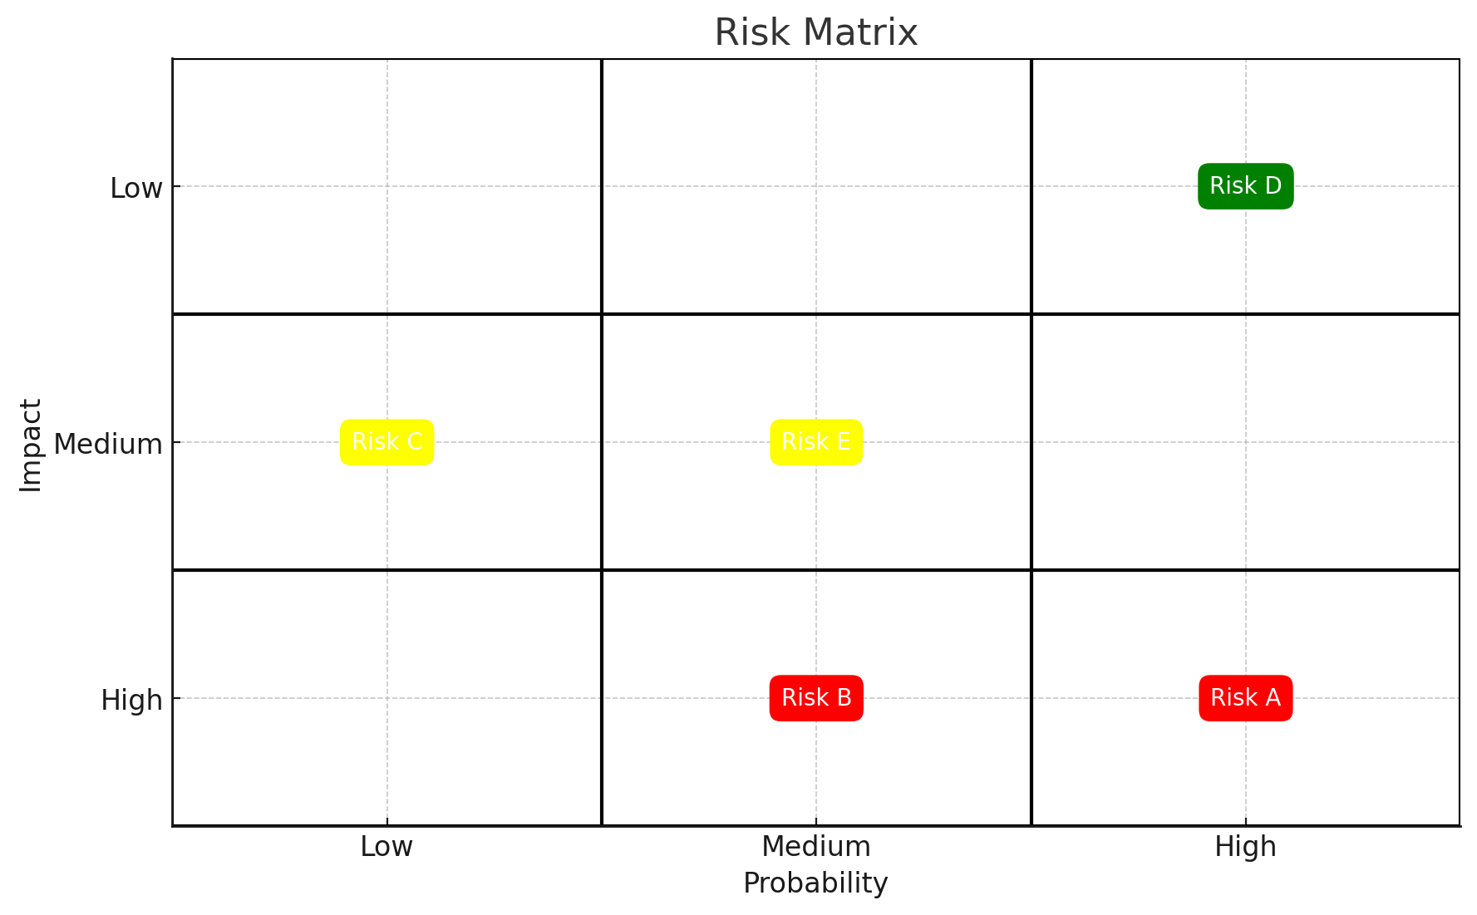
4. Implementing Risk Charts to Enhance Project Safety and Success
Here's a visual representation of a risk matrix with several example risks plotted based on their probability and impact. Each risk is placed in the appropriate cell according to its assigned probability (horizontal axis) and impact (vertical axis). Different colors represent the severity of the impact, helping to easily identify and prioritize risks for mitigation.

Slide 27
4. Implementing Risk Charts to Enhance Project Safety and Success
5. Analyze and Prioritize
Examine the matrix to determine which risks need immediate attention:
High Probability, High Impact: Top priority, require immediate action and detailed plans to mitigate.
High Probability, Low Impact: May require simple corrective measures.
Low Probability, High Impact: Plan contingencies as these could be catastrophic, albeit unlikely.
Low Probability, Low Impact: Monitor periodically, but they may require minimal immediate action.

Slide 28
4. Implementing Risk Charts to Enhance Project Safety and Success
6. Develop Mitigation Strategies
For each risk, especially those in the high-impact or high-probability categories, develop a mitigation strategy. This may involve:
Avoidance: Changing project parameters to avoid the risk.
Reduction: Implementing measures to reduce the impact or likelihood of the risk.
Transfer: Outsourcing the risk to a third party (e.g., through insurance).
Acceptance: Acknowledging the risk and preparing to handle its impacts if it occurs.

Slide 29
4. Implementing Risk Charts to Enhance Project Safety and Success
7. Monitor and Review
Risk management is a continuous process. Regularly update the risk matrix as the project progresses and as new risks emerge. This will involve reassessing the probability and impact of risks, as well as the effectiveness of mitigation strategies.
8. Communicate
Share the risk matrix with all stakeholders and the project team. Effective communication ensures that everyone understands the potential risks and the strategies in place to manage them.

Slide 30
4. Implementing Risk Charts to Enhance Project Safety and Success
Risk charts are essential for proactive project management, allowing teams to handle uncertainties more effectively and to navigate projects towards successful completion.

Slide 31
4. Implementing Risk Charts to Enhance Project Safety and Success
Which of the following best describes risk charts?
A) They determine the project budget.
B) They identify potential project risks and their impacts.
C) They are used for stakeholder management.
D) They track team performance.

Slide 32
4. Implementing Risk Charts to Enhance Project Safety and Success
What is the primary purpose of using risk charts in project management?"
A) To identify potential project risks and their impacts. B) To determine the project budget. C) To manage stakeholder expectations. D) To schedule project tasks.
Risk charts, or risk matrices, help us visualize and prioritize risks based on their likelihood and potential impact on the project. This visualization supports proactive risk management, crucial for minimizing delays and cost overruns. An example here in Australia might be using a risk chart to assess and mitigate risks for a construction project in Brisbane, considering factors like weather delays or supply chain disruptions.

Slide 33
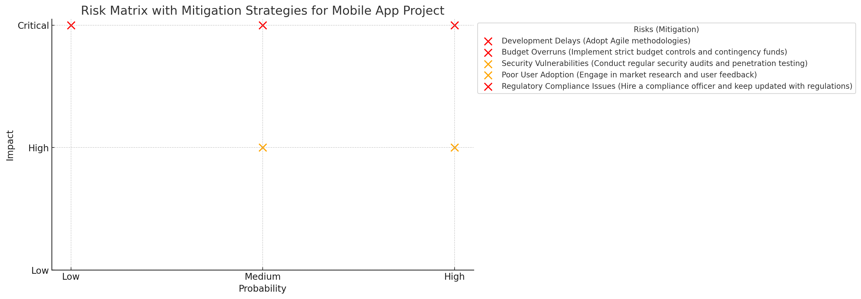
4. Implementing Risk Charts to Enhance Project Safety and Success
Exercise) Develop a risk chart for the mobile app project. Identify at least 5 potential risks and their mitigation strategies.
Answer includes potential risks like development delays, budget overruns, etc., with mitigation strategies like agile development, contingency funds, etc.

Slide 34
4. Implementing Risk Charts to Enhance Project Safety and Success
This visualization provides a clear overview of the risks based on their probability and impact, along with the steps to address them:
Development Delays: High probability and impact, mitigated by adopting Agile methodologies.
Budget Overruns: Medium probability and high impact, managed through strict budget controls and establishing contingency funds.

Slide 35
4. Implementing Risk Charts to Enhance Project Safety and Success
Security Vulnerabilities: High probability and medium impact, addressed through regular security audits and penetration testing.

Slide 36
4. Implementing Risk Charts to Enhance Project Safety and Success
Poor User Adoption: Medium probability and impact, mitigated by engaging in market research and collecting user feedback.
Regulatory Compliance Issues: Low probability but high impact, managed by hiring a compliance officer and staying updated with regulations.
The chart categorizes risks and provides tailored mitigation strategies, aiding in effective risk management planning.

Slide 37
5. 12-step Project Management Process:
The 12-step Project Management Process is a structured approach that guides project managers through all phases of a project, from initiation to closure. This comprehensive framework ensures that all critical aspects of project management are systematically addressed, helping to maximize efficiency and success. Here's an overview of each step in the process:

Slide 38
5. 12-step Project Management Process:
1. Initiation
Define the Project: Establish clear objectives, scope, and deliverables of the project based on the needs and expectations of stakeholders.
Identify Stakeholders: Recognize all parties involved or affected by the project and understand their interests and impact.

Slide 39
5. 12-step Project Management Process:
2. Feasibility Study
Assess Feasibility: Conduct a feasibility study to analyze the viability of the project in terms of technical requirements, budget, timeline, and resources.
3. Project Charter
Develop the Project Charter: Create a document that formally authorizes the project, outlining the project vision, objectives, scope, organization, and key milestones.

Slide 40
5. 12-step Project Management Process:
4. Project Team Assembly
Assemble Team: Put together a team with the necessary skills, roles, and responsibilities to successfully deliver the project.
5. Planning
Create a Project Plan: Develop a detailed plan that includes project schedule, resources, budget, procurement, risk management, and communication strategies.

Slide 41
5. 12-step Project Management Process:
6. Project Schedule
Develop a Schedule: Create a timeline that includes all project tasks and milestones. Use tools like Gantt charts to visualize and track progress.
7. Resource Allocation
Allocate Resources: Assign resources effectively, ensuring that manpower, materials, and budget are available as needed to meet project timelines and objectives.

Slide 42
5. 12-step Project Management Process:
8. Risk Management Planning
Identify and Assess Risks: Determine potential risks to the project and assess their impact and probability.
Plan Risk Mitigation: Develop strategies to mitigate identified risks.
9. Project Execution
Execute the Plan: Implement the project plan according to the schedule, resources, and tasks defined.

Slide 43
5. 12-step Project Management Process:
10. Monitoring and Control
Track Progress: Regularly monitor the progress against the project plan.
Manage Changes: Control changes to the project scope, schedule, and costs through a formal change management process.
11. Quality Management
Ensure Quality: Implement quality management processes to ensure that the project deliverables meet the predefined standards and stakeholder expectations.

Slide 44
5. 12-step Project Management Process:
12. Project Closure
Close the Project: Conduct a formal project closure process to finalize all activities, release resources, and hand over deliverables.
Evaluate and Document: Review project outcomes against the initial objectives, document lessons learned, and provide recommendations for future projects.
These steps form a cycle that may need to be revisited iteratively as the project progresses. Managing a project using this 12-step process ensures a systematic approach, helping project managers and their teams achieve the project goals efficiently while handling resources effectively.

Slide 45
6. Collaborative Strategies
Collaborative strategies in developing marketing and financial plans involve harnessing the collective skills, experiences, and insights of a team to address entrepreneurial challenges effectively. This approach not only improves the quality of the plans but also fosters a sense of ownership and commitment among team members. Here’s how to implement collaborative strategies effectively in our business planning process:

Slide 46
6. Collaborative Strategies
1. Establish Clear Objectives
Define clear, measurable goals for both the marketing and financial aspects of your plans. Ensure that all team members understand these goals and how their contributions will help achieve them.
2. Assemble Diverse Teams
Include members from different backgrounds and departments (e.g., marketing, finance, sales, product development) to bring a variety of perspectives and expertise to the table. Diversity in skills and perspectives can lead to more innovative and comprehensive strategies.

Slide 47
6. Collaborative Strategies
3. Facilitate Open Communication
Create an environment where open and honest communication is encouraged. Use tools like regular meetings, collaborative software, and team workshops to facilitate dialogue.
Ensure all ideas are heard and considered, promoting an inclusive atmosphere.
4. Use Collaborative Tools
Employ project management and collaboration tools (like Slack, Microsoft Teams, Trello, or Asana) that enable document sharing, real-time editing, communication, and progress tracking.

Slide 48
6. Collaborative Strategies
5. Jointly Develop Marketing Plans
Market Research: Conduct research as a team to gather insights on market trends, customer needs, and competitor strategies. This should involve contributions from team members who interact directly with customers as well as from analysts.
Strategy Formulation: Develop marketing strategies as a group. Brainstorm sessions can be used to generate creative marketing tactics and channels.
Execution Planning: Assign roles and responsibilities clearly, ensuring each member knows what is expected in the implementation of marketing strategies.

Slide 49
6. Collaborative Strategies
6. Co-create Financial Plans
Budgeting: Collaborate on setting budgets that align with marketing strategies and business goals. Finance team members can provide data and forecasts, while marketing and sales can provide insight into necessary expenditures for campaigns.
Forecasting: Work together to predict future financial outcomes based on different scenarios. This should include input from all departments to ensure realistic and comprehensive forecasting.
Risk Management: Identify potential financial risks and develop mitigation strategies as a team. This approach ensures that all potential impacts are considered and addressed.

Slide 50
6. Collaborative Strategies
7. Regular Review and Adjustments
Hold regular review meetings to assess the progress of the plans against the set objectives. This allows the team to make timely adjustments based on performance, market changes, and other external factors.
Celebrate successes and analyze setbacks as a team to learn and improve continuously.

Slide 51
6. Collaborative Strategies
8. Training and Development
Invest in training and development programs to enhance team members' skills in areas such as digital marketing, data analysis, financial management, and strategic planning. This elevates the team's ability to contribute effectively.
9. Feedback Mechanism
Implement a system for providing constructive feedback. This should be a two-way mechanism where team members can give and receive feedback on their contributions and collaborative practices.

Slide 52
6. Collaborative Strategies
10. Document and Share Learning
Keep detailed records of meetings, strategies, and outcomes. Use these documents as learning tools and a basis for future planning sessions.
By fostering a collaborative environment, we not only enhance the effectiveness of our marketing and financial plans but also build a stronger, more cohesive team capable of navigating the complexities of entrepreneurial ventures.

Slide 53
7. Examples of Entrepreneurial Project Management
1. Launching a new tech startup.
2. Developing a new software product.
3. Creating a mobile app for social networking.
4. Expansion of a small e-commerce business.
5. Implementing a new business model in an existing company.
6. Developing an online learning platform.
7. Launching a digital marketing campaign.

Slide 54
7. Examples of Entrepreneurial Project Management
8. Setting up a crowdfunding campaign for a new product.
9. Implementing a CRM system for better customer engagement.
10. Developing a new game with a small team.
11. Organizing a virtual reality expo.
12. Launching a freelance graphic design service.
13. Setting up an organic cafe.
14. Developing a fintech service.

Slide 55
7. Examples of Entrepreneurial Project Management
15. Planning and launching a co-working space.
16. Organizing a tech workshop or seminar.
17. Implementing green technologies in existing operations.
18. Planning a new logistics framework for e-commerce.
19. Developing an AI-powered customer service tool.
20. Launching a health tech startup.

Slide 56
8. Case Studies Relating to AI, Software, and Game Development
1. AI for Predictive Maintenance: How a startup used AI to predict machinery failure, reducing downtime.
2. Mobile Game Development: The journey of a small team creating a successful mobile game.
3. Software as a Service (SaaS): The development and scaling of a SaaS platform.
4. Virtual Reality Training Software: Implementation in medical education.

Slide 57
8. Case Studies Relating to AI, Software, and Game Development
5. Blockchain for Secure Transactions: A startup's approach to enhancing e-commerce security.
6. AI in E-commerce: Customizing user experiences with AI.
7. Cloud Computing Services: A startup providing cloud solutions to small businesses.
8. Cybersecurity Solutions: Developing advanced security software.
9. Data Analytics Platform: How data is transforming marketing strategies.

Slide 58
8. Case Studies Relating to AI, Software, and Game Development
10. AI in Agriculture: Creating predictive models for crop management.
11. Educational Software for Remote Learning: Innovations during the COVID-19 pandemic.
12. Game Development with AI: Enhancing user experience in games.
13. Healthcare App Development: A startup's approach to patient management systems.
14. AI for Environmental Monitoring: Using AI to track environmental changes.

Slide 59
8. Case Studies Relating to AI, Software, and Game Development
15. Software for Real Estate Management: Automating property management processes.
16. E-sports Platform Development: Building a community and platform for gamers.
17. AI in Logistics: Optimizing delivery routes and times.
18. Smart Home Technology: Developing integrated home systems.
19. Wearable Fitness Technology: Combining health monitoring and technology.
20. Financial Planning Software: AI-driven solutions for personal finance management.

Slide 60
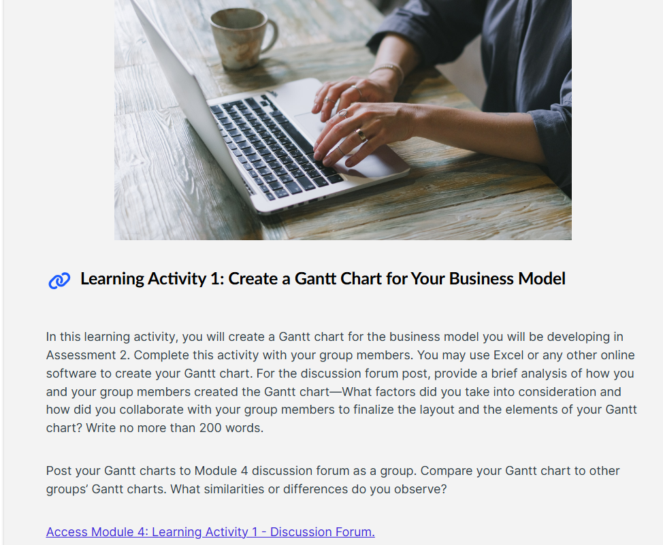
9. Learning Activities
https://www.onlinegantt.com/#/

Slide 61
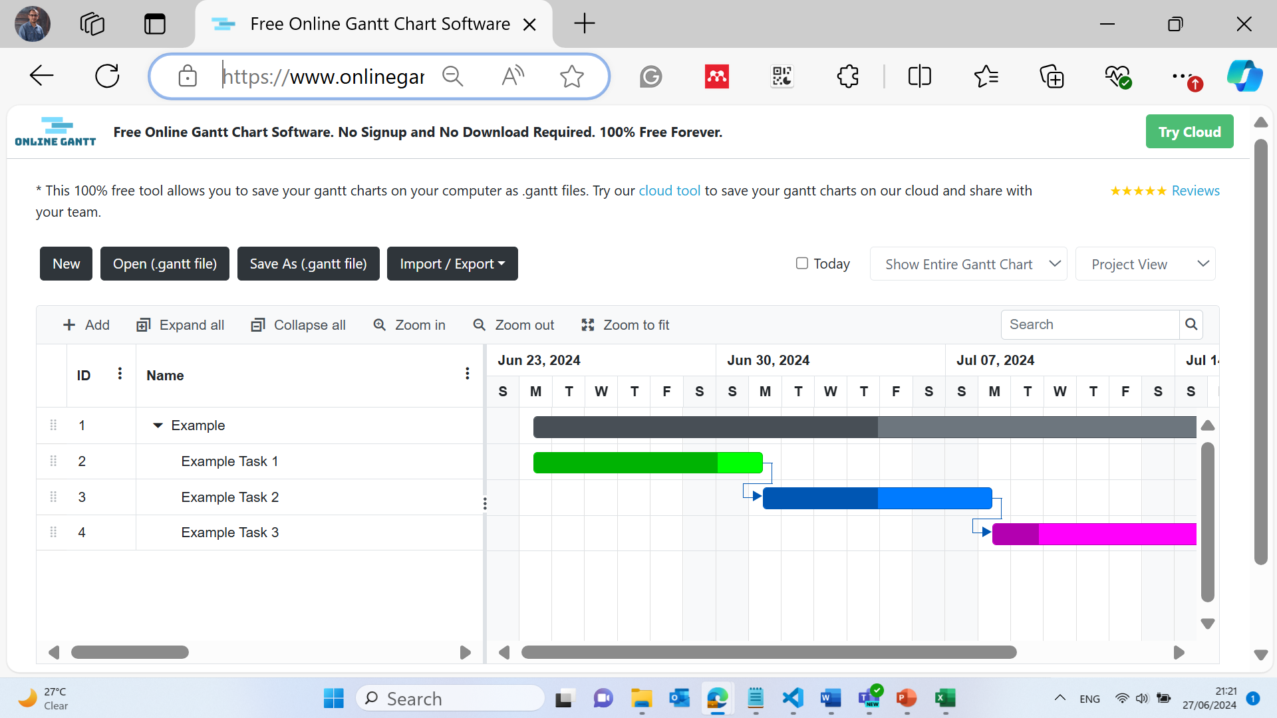
9. Learning Activities

Slide 62
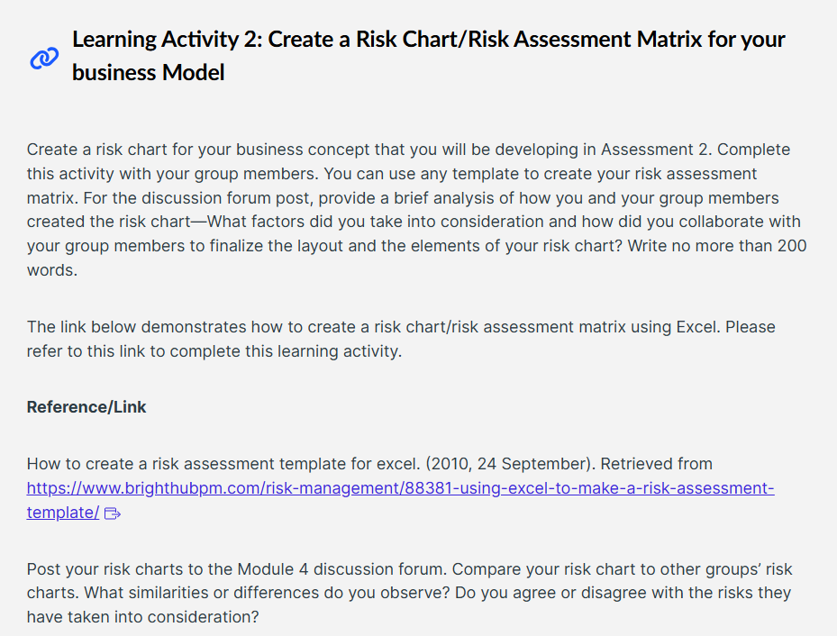
9. Learning Activities

Slide 63
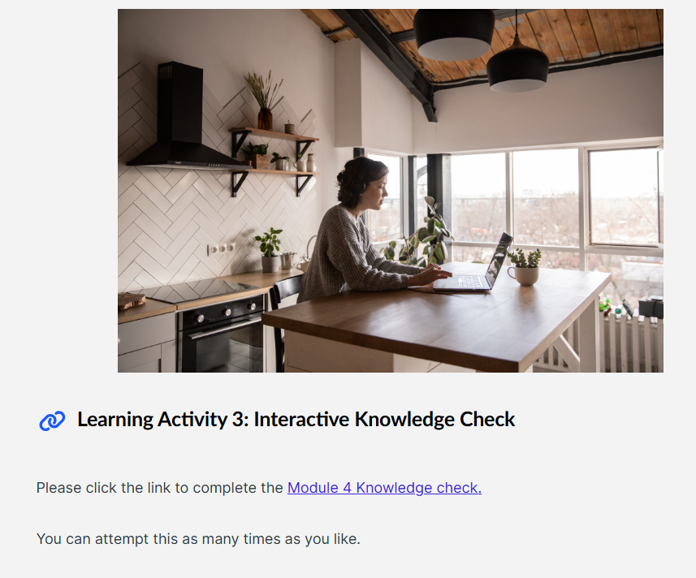
9. Learning Activities

Slide 64

10. Attendance

Slide 65
11. Preparation for Assessment 2
Step-by-Step Guide to Achieving High Distinction in Assessment 2
1. Form a Well-Balanced Group:
Form a group with students who bring diverse skills to the table—coding, market analysis, writing, and project management.
Ensure all group members are committed and understand the roles they will play.

Slide 66
11. Preparation for Assessment 2
2. Identify and Understand the Market Gap:
Revisit the findings from Assessment 1 regarding the market gap.
Conduct additional research to deepen your understanding of the problem and confirm the gap in the current market.
3. Develop an Innovative Business Concept:
Brainstorm innovative solutions that are not only unique but feasible.
Evaluate each idea against the market gap and potential technical challenges.
Select the most viable solution that offers a clear competitive advantage.

Slide 67
11. Preparation for Assessment 2
4. Competitive Analysis:
Perform a thorough competitive analysis to identify similar existing solutions.
Use resources like industry reports, academic journals, and market analysis tools.
Highlight what sets your concept apart from competitors in terms of innovation, efficiency, cost, etc.

Slide 68
11. Preparation for Assessment 2
5. Develop the Software Program Prototype:
Choose the appropriate technology stack for your prototype based on the project requirements and team skills.
Write clean, efficient, and well-commented code to ensure it is easy to understand and debug.
Test the prototype rigorously to ensure it works flawlessly and meets the project objectives.

Slide 69
11. Preparation for Assessment 2
6. Write a Detailed Report:
Introduction: Clearly define the problem and how your solution addresses it.
Body: Describe your solution, the technology used, and the implementation strategy. Include diagrams, flowcharts, and code snippets.
Competitive Analysis: Detail your findings and how they justify your business concept.
Marketing Strategy and Financial Plan: Outline how you plan to market and monetize your solution.
Conclusion: Summarize the potential impact of your solution on the market and any future developments.

Slide 70
11. Preparation for Assessment 2
7. Prepare a 2-Minute Recording Explaining Your Code:
Briefly explain the purpose of the code and how it implements the business concept.
Discuss key functions and their roles in the overall functionality.
Ensure all team members participate and contribute to the presentation.
8. Review and Edit:
Review the report and code thoroughly to ensure they are error-free and well-presented.
Check that all APA citations are correct and that all resources are credible and relevant.

Slide 71
11. Preparation for Assessment 2
9. Submit All Required Components:
Ensure that the report, code, and video are formatted correctly and submitted before the deadline.

Slide 72
11. Preparation for Assessment 2
For the market gap identification:
What existing solutions currently address this market gap, and how does our solution provide a better alternative?
While there are solutions that address parts of this gap, our solution integrates all aspects into a single platform, providing a more efficient and cost-effective service. For example, if we consider the gap in accessible healthcare services in rural Australia, existing solutions may focus only on remote consultations. Our platform integrates AI-driven diagnostics which can predict patient needs and automate parts of the consultation process, reducing the need for constant human intervention.

Slide 73
11. Preparation for Assessment 2
For the Software Prototype:
Our code utilizes Python and Flask for backend development, ensuring it is lightweight and scalable. We've incorporated AI using TensorFlow to analyze user data and provide predictions. This integration is crucial for automating responses and improving user experience.
By following these guidelines and focusing on the clarity of presentation, innovation, and technical robustness, you can aim to achieve a high distinction in Assessment 2.

Slide 74
11. Preparation for Assessment 2
1. Health Sector: Telehealth System Prototype
Python Use Case:
Objective: Develop a platform that facilitates remote consultations and patient monitoring.
Features: Video calling, real-time health data monitoring, AI-driven preliminary diagnosis.
Python Libraries:
flask for the web server.
opencv-python for handling video streams.
pandas for managing patient data.
scikit-learn for machine learning models to predict health conditions.

Slide 75
11. Preparation for Assessment 2
Prototype Code (Python) in business
2. Business Sector: Customer Relationship Management (CRM) System
Python Use Case:
Objective: Manage customer interactions, sales tracking, and after-sales support.
Features: Customer data management, interaction tracking, support ticketing.
Python Framework: Django for robust database management and routing.

Slide 76
11. Preparation for Assessment 2
Prototype Code (C#) in business
2. Business Sector: Customer Relationship Management (CRM) System
C# Use Case:
Objective: Sales lead tracking and performance reporting system.
Features: Lead management, sales conversion tracking, customized reports.
C# Technologies: ASP.NET MVC for a multi-layered architecture that separates concerns effectively, enabling better manageability and scalability.

Slide 77
11. Preparation for Assessment 2
Prototype Code (Python) in Sustainable Design
3. Sustainable Design: Smart Energy Management System
Python Use Case:
Objective: Optimize energy use in buildings using IoT data.
Features: Real-time energy consumption analysis, predictive maintenance alerts, sustainability reporting.
Python Libraries: pandas for data analysis, matplotlib for plotting, sklearn for building prediction models.

Slide 78
11. Preparation for Assessment 2
Prototype Code (C#) in Sustainable Design
3. Sustainable Design: Smart Energy Management System
C# Use Case:
Objective: Development of a system for managing renewable energy sources integration into the home grid.
Features: Integration with solar panels, real-time energy pricing, battery management.
C# Technologies: .NET Core for backend, SignalR for real-time communication.

Slide 79
11. Preparation for Assessment 2
The prototype should include detailed comments and should be designed considering modularity, scalability, and robustness to ensure they align with the high standards expected in the CEN207 assessment 2. This approach not only demonstrates the application of programming knowledge but also encourages practical, industry-relevant software development skills.

Slide 80
** Integrating AI in Game Development: A Practical Approach

Slide 81
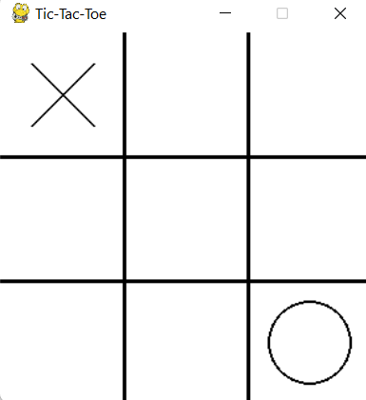
** Integrating AI in Game Development: A Practical Approach
Game Overview
The game is a standard Tic-Tac-Toe where two players ("Human" and "AI") take turns to mark spaces in a 3x3 grid. The objective is to achieve three consecutive marks horizontally, vertically, or diagonally. The game ends when all spaces are filled or a player wins.

Slide 82
** Integrating AI in Game Development: A Practical Approach
Game Mechanics
Players: Two players participate in the game. The "Human" player uses 'X' and the AI uses 'O'.
Turns: The players alternate turns, starting with the "Human."
End Conditions: The game ends if a player wins or if all spaces are filled, resulting in a draw.

Slide 83
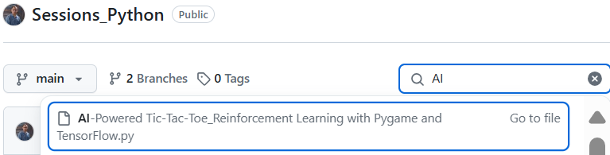
** Integrating AI in Game Development: A Practical Approach

Slide 84
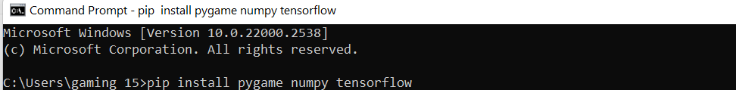
** Integrating AI in Game Development: A Practical Approach
pip install pygame numpy tensorflow
Before running the code, make sure these necessary libraries are installed.
Required Libraries
Before running the code, make sure you have these libraries installed:
pygame for the game interface.
numpy for handling arrays and matrix operations.
TensorFlow for machine learning components.

Slide 85
** Integrating AI in Game Development: A Practical Approach
Import Necessary Libraries
import sys
import random
import numpy as np
import pygame
from tensorflow.keras.models import Sequential
from tensorflow.keras.layers import Dense
from tensorflow.keras.optimizers import Adam
Imports: Necessary libraries for game mechanics, neural networks, and basic Python functionality.

Slide 86
** Integrating AI in Game Development: A Practical Approach
# Initialize Pygame
pygame.init()
# Set up the display for the game
width, height = 300, 300
screen = pygame.display.set_mode((width, height))
pygame.display.set_caption('Tic-Tac-Toe')
# Colors
black = (0, 0, 0)
white = (255, 255, 255)
# Game variables
board = [0] * 9 # Represents a 3x3 grid
game_over = False
player_turn = True # True if player's turn, False for AI
# Initialize font, adjusting size to fit better
font = pygame.font.Font(None, 28)
# Neural Network for the AI Player
model = Sequential()
model.add(Dense(64, input_dim=9, activation='relu')) # Input layer for 9 board positions
model.add(Dense(64, activation='relu')) # Hidden layer
model.add(Dense(9, activation='linear')) # Output layer for each move's Q-value
model.compile(loss='mse', optimizer=Adam())
2. Initilisation:
Pygame Initialization: Starts the Pygame engine to manage game elements.
Display Setup: A window of size 300x300 pixels is created.
Font Initialization: A font of size 28 is created for text rendering.
Model Initialization: A neural network model with three layers is defined and compiled for predicting AI moves.

Slide 87
** Integrating AI in Game Development: A Practical Approach
3. Drawing the Board:
def draw_board():
screen.fill(white)
for i in range(1, 3):
pygame.draw.line(screen, black, (0, 100 * i), (300, 100 * i), 3)
pygame.draw.line(screen, black, (100 * i, 0), (100 * i, 300), 3)
for index, value in enumerate(board):
x = (index % 3) * 100 + 50
y = (index // 3) * 100 + 50
if value == 1:
pygame.draw.line(screen, black, (x - 25, y - 25), (x + 25, y + 25), 2)
pygame.draw.line(screen, black, (x + 25, y - 25), (x - 25, y + 25), 2)
elif value == -1:
pygame.draw.circle(screen, black, (x, y), 34, 2)
Draw Lines: Draws the Tic-Tac-Toe grid.
Draw Marks: Depending on the board state, draws 'X' or 'O' in the appropriate grid cell.

Slide 88
** Integrating AI in Game Development: A Practical Approach
4. Win Condition Check:
def check_win():
win_positions = [
(0, 1, 2), (3, 4, 5), (6, 7, 8),
(0, 3, 6), (1, 4, 7), (2, 5, 8),
(0, 4, 8), (2, 4, 6)
]
for a, b, c in win_positions:
if board[a] == board[b] == board[c] != 0:
return 'Human' if board[a] == 1 else 'AI'
if 0 not in board:
return 'Draw'
return None
Winning Positions: Checks predefined winning line combinations.
Determine Winner: Returns which player won or if the game is a draw.

Slide 89
** Integrating AI in Game Development: A Practical Approach
5. AI decision making
def ai_move():
"""AI chooses the best move based on the neural network prediction."""
state = np.array(board).reshape(1, -1)
predictions = model.predict(state)[0]
# Apply a mask to remove illegal moves (positions already taken)
legal_moves = [i if x == 0 else -1e7 for i, x in enumerate(board)]
move = np.argmax(np.array(predictions) + np.array(legal_moves))
return move if board[move] == 0 else None
Predictive Model: Uses the neural network to predict the move values based on the current board state.
Legal Moves: Ensures the AI only considers legal (empty) positions.
Choose Best Move: The AI picks the position with the highest predicted value.

Slide 90
** Integrating AI in Game Development: A Practical Approach
6. Message Display
def display_message(message):
message_screen = pygame.display.set_mode((300, 150))
pygame.display.set_caption('Game Over')
message_screen.fill(white)
text = font.render(message, True, black)
text_rect = text.get_rect(center=(150, 75))
message_screen.blit(text, text_rect)
pygame.display.flip()
pygame.time.wait(2000)
pygame.display.quit()
New Window: Opens a new smaller window to display the game result.
Render and Display Text: Shows the final game outcome.

Slide 91
** Integrating AI in Game Development: A Practical Approach
7. Main Game Loop
# Main game loop
while not game_over:
draw_board()
for event in pygame.event.get():
if event.type == pygame.QUIT:
sys.exit()
elif event.type == pygame.MOUSEBUTTONDOWN and event.button == 1 and player_turn:
x, y = pygame.mouse.get_pos()
index = (x // 100) + (y // 100) * 3
if board[index] == 0:
board[index] = 1
result = check_win()
if result is not None:
game_over = True
player_turn = False
if not player_turn and not game_over:
index = ai_move()
if index is not None:
board[index] = -1
result = check_win()
if result is not None:
game_over = True
player_turn = True
pygame.display.flip()
if game_over:
result = check_win()
message = "Congratulations! You've won the game!" if result == 'Human' \
else "Your hard work is commendable, but you need to try more." if result == 'AI' \
else "Game Over. It's a draw."
display_message(message)
pygame.quit()
sys.exit()
Event Handling: Processes quitting the game or human player moves.
AI Moves: If it's the AI's turn, it calculates and makes a move.
Update Display: Refreshes the game window to reflect the current state.

Slide 92
** Integrating AI in Game Development: A Practical Approach
Conclusion
The game loop runs continuously, updating and redrawing the board, handling player inputs, and executing AI moves until the game concludes. When the game ends, it triggers a message display showing who won or if it was a draw, and then it cleanly exits the program. This setup provides an interactive platform for testing both simple game dynamics and more complex AI strategies using a neural network.

Slide 93
** Integrating AI in Game Development: A Practical Approach
The role of each Python library?
A) Pygame: handles the game interface
B) TensorFlow: manages the neural network
C) Numpy: is used for handling arrays and matrix operations
D) Pandas, primarily used for data manipulation and analysis, is not directly involved in neural network creation or game interface management

Slide 94

Happy A Learning Day!
Dr. Farshid Keivanian

